Slide 1

Furniture Sales Forecasting
This project aims to predict future sales for a furniture store using a machine learning model. By analyzing historical data including order details, customer information, product categories, and sales performance, the model will forecast future sales trends, which can benefit inventory management, marketing strategies, and financial planning.

Slide 2
Dataset Overview
Data Sources
Data Structure
Data Cleaning
The dataset comprises historical sales records, customer demographics, product information, and marketing campaign details.
The data is organized in a structured format, with each row representing a unique transaction and columns containing relevant attributes like order date, product ID, quantity, price, customer ID, and marketing channel.
Prior to analysis, data cleaning is performed to handle missing values, inconsistent data formats, and outliers, ensuring data quality and accuracy.

Slide 3

Feature Engineering and Preprocessing
1
Feature Extraction
2
Feature Scaling
New features are derived from existing ones to improve model performance. For example, creating a "seasonality" feature by extracting the month from the order date.
Numerical features are scaled to a common range to prevent certain features from dominating the model due to larger magnitudes.
3
Categorical Encoding
4
Data Splitting
Categorical variables, such as product category or customer location, are converted into numerical values using techniques like one-hot encoding.
The dataset is split into training and testing sets to evaluate the model's performance on unseen data.

Slide 4




Exploratory Data Analysis
Trend Analysis
Visualize historical sales patterns over time to identify trends, seasonality, and potential anomalies.
Customer Segmentation
Analyze customer demographics and purchase behavior to identify different customer segments and understand their preferences.
Product Performance
Evaluate sales performance of different product categories, identifying top-selling items and potential areas for improvement.

Slide 5

Model Selection and Training
Model
Description
Linear Regression
A simple model for predicting continuous values based on a linear relationship between features and the target variable.
Time Series Models (ARIMA, Prophet)
Specialized models for analyzing and predicting time-series data, considering temporal dependencies and seasonality.
Neural Networks
More complex models capable of learning non-linear relationships between features and the target variable.

Slide 6




Model Evaluation and Validation
Accuracy
Measures the model's ability to correctly predict sales values.
Error Metrics
Quantifies the difference between predicted and actual sales values, including mean squared error (MSE) and root mean squared error (RMSE).
Cross-Validation
A technique to assess the model's generalization ability by training and evaluating it on multiple subsets of the data.

Slide 7

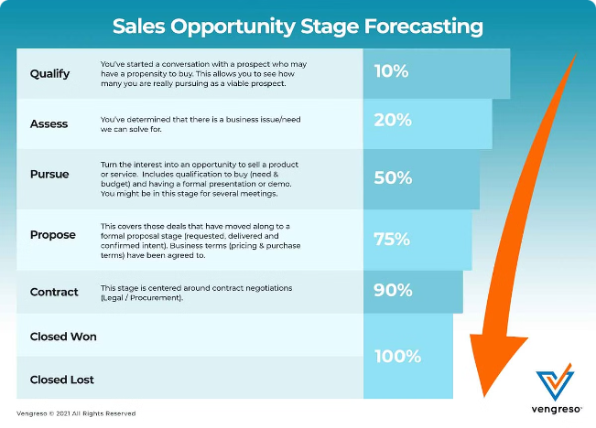
Forecasting Future Sales Trends
1
Short-Term Forecasts
Predict sales for the upcoming weeks or months, useful for inventory planning and marketing campaigns.
2
Mid-Term Forecasts
Predict sales for the next few quarters, valuable for resource allocation and financial planning.
3
Long-Term Forecasts
Predict sales for the next year or even longer, aiding in strategic decision-making and long-term business planning.

Slide 8
Code for the given problem statement
import pandas as pd
#Load the dataset
file_path = '/content/sample_data/Super_Store_data.csv' df = pd.read_csv(file_path,encoding='latin1')
#Display the first few rows of the dataset
print(df.head())
#Check for missing values
print(df.isnull().sum())
#Handle missing values (if any)
df = df.dropna()
#Convert categorical columns to numerical values using one-hot encoding
df = pd.get_dummies(df, drop_first=True)
#Check the correlation with the target variable (assuming 'Sales' is the target)
corr_matrix = df.corr() print(corr_matrix['Sales'].sort_values(ascending=False))
#Print the available columns after get_dummies to see the correct names
print(df.columns)
#Select features with a high correlation to 'Sales'
#Make sure to use the updated column names from the previous print statement
features = df[['Row ID']] # Replace with actual feature names, 'Order ID' and 'Customer ID' are no longer available target = df['Sales']
#Split the data into training and testing sets
from sklearn.model_selection import train_test_split X_train, X_test, y_train, y_test = train_test_split(features, target, test_size=0.2, random_state=42) from sklearn.linear_model import LinearRegression from sklearn.metrics import mean_squared_error, r2_score
#Initialize and train the model
model = LinearRegression() model.fit(X_train, y_train)
#Make predictions on the test set
y_pred = model.predict(X_test)
#Evaluate the model
mse = mean_squared_error(y_test, y_pred) r2 = r2_score(y_test, y_pred)
print(f'Mean Squared Error: {mse}') print(f'R-squared: {r2}')
#Example of making future predictions
new_data = pd.DataFrame({ 'Row ID': [0,1,2,3,4,5,6,7,8,9,10,11,12,13,14,15,16,17,18,19,20,21,22,23,24,25] # Replace with actual values })
#Predict future sales
future_sales = model.predict(new_data) print(f'Predicted future sales: {future_sales}')

Slide 9
Output for the problem statement
Row ID Order ID Order Date Ship Date Ship Mode Customer ID
0 1 CA-2016-152156 11/8/2016 11/11/2016 Second Class CG-12520 1 2 CA-2016-152156 11/8/2016 11/11/2016 Second Class CG-12520 2 4 US-2015-108966 10/11/2015 10/18/2015 Standard Class SO-20335 3 6 CA-2014-115812 6/9/2014 6/14/2014 Standard Class BH-11710 4 11 CA-2014-115812 6/9/2014 6/14/2014 Standard Class BH-11710
CustomerName Segment Country City ... Postal Code \
0 Claire Gute Consumer United States Henderson ... 42420 1 Claire Gute Consumer United States Henderson ... 42420 2 Sean O'Donnell Consumer United States Fort Lauderdale ... 33311 3 Brosina Hoffman Consumer United States Los Angeles ... 90032 4 Brosina Hoffman Consumer United States Los Angeles ... 90032
Region Product ID Category Sub-Category 0 South FUR-BO-10001798 Furniture Bookcases 1 South FUR-CH-10000454 Furniture Chairs 2 South FUR-TA-10000577 Furniture Tables 3 West FUR-FU-10001487 Furniture Furnishings 4 West FUR-TA-10001539 Furniture Tables
Product Name Sales Quantity \
0 Bush Somerset Collection Bookcase 261.9600 2 1 Hon Deluxe Fabric Upholstered Stacking Chairs,... 731.9400 3 2 Bretford CR4500 Series Slim Rectangular Table 957.5775 5 3 Eldon Expressions Wood and Plastic Desk Access... 48.8600 7 4 Chromcraft Rectangular Conference Tables 1706.1840 9
Discount Profit 0 0.00 41.9136 1 0.00 219.5820 2 0.45 -383.0310 3 0.00 14.1694 4 0.20 85.3092
Row ID 0
Order ID 0 Order Date 0
Ship Date 0 Ship Mode 0
Customer ID 0 Customer Name 0
Segment 0 Country 0 City 0 State 0 Postal Code 0 Region 0
Product ID 0 Category 0 Sub-Category 0 Product Name 0 Sales 0 Quantity 0 Discount 0 Profit 0
dtype: int64
Sales 1.000000 Quantity 0.437464
Product Name_HON 5400 Series Task Chairs for Big and Tall 0.291594 Product ID_FUR-CH-10002024 0.291594 Product ID_FUR-BO-10004834 0.267890 ...

Slide 10
Product ID_FUR-FU-10004270 -0.056008 Product Name_Staple-based wall hangings -0.056054 State_Illinois -0.059166 City_Chicago -0.060084
Sub-Category_Furnishings -0.457835 Name: Sales, Length: 6209, dtype: float64 Index(['Row ID', 'Postal Code', 'Sales', 'Quantity', 'Discount', 'Profit', 'Order ID_CA-2014-100678', 'Order ID_CA-2014-100706', 'Order ID_CA-2014-100916', 'Order ID_CA-2014-101462', ... '
Product Name_Tensor Brushed Steel Torchiere Floor Lamp', 'Product Name_Tensor Computer Mounted Lamp', 'Product Name_Tensor Track Tree Floor Lamp', 'Product Name_Ultra Commercial Grade Dual Valve Door Closer', 'Product Name_Ultra Door Kickplate, 8"H x 34"W', 'Product Name_Ultra Door Pull Handle', 'Product Name_Ultra Door Push Plate', 'Product Name_Westinghouse Clip-On Gooseneck Lamps', 'Product Name_Westinghouse Floor Lamp with Metal Mesh Shade, Black', 'Product Name_Westinghouse Mesh Shade Clip-On Gooseneck Lamp, Black'],
dtype='object', length=6209) Mean Squared Error: 306563.5646297518 R-squared: -0.00046797502100925925 Predicted future sales: [355.89500454 355.89411216 355.89321978 355.89232739 355.89143501 355.89054262 355.88965024 355.88875785 355.88786547 355.88697309 355.8860807 355.88518832 355.88429593 355.88340355 355.88251116 355.88161878 355.88072639 355.87983401 355.87894163 355.87804924 355.87715686 355.87626447 355.87537209 355.8744797 355.87358732 355.87269493]

Slide 11
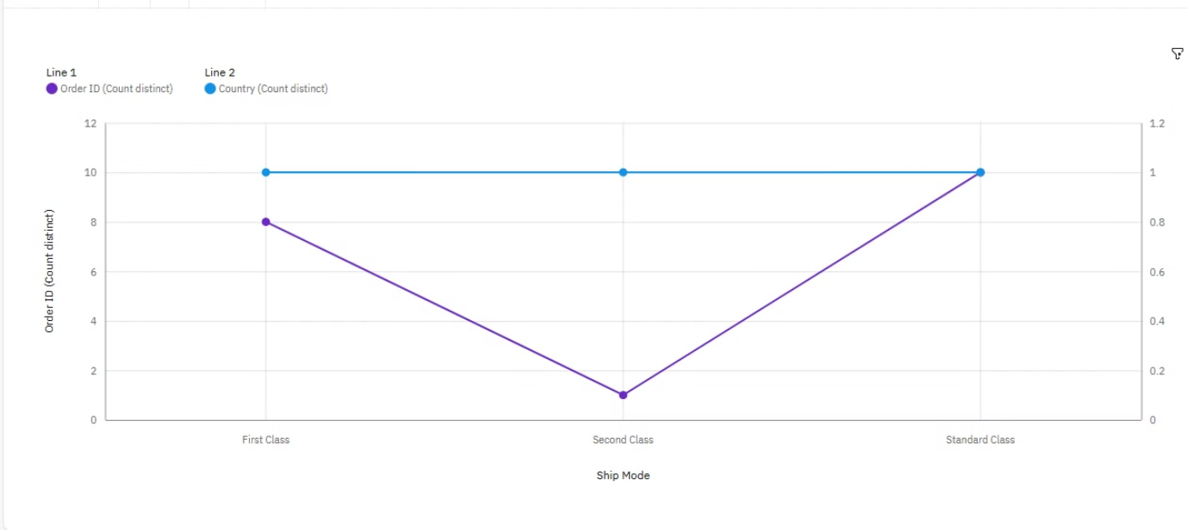
Visulization
ORDER ID WITH SHIP MODE(DUAL LINE CHART)
Ship Mode Standard Class has the highest Order ID due to City Chester. City Oklahoma City has the highest Order ID at 2, out of which Ship Mode First Class contributed the most at 1. First Class has a Order ID of 1 for City Jacksonville. Standard Class (56 %) and First Class (40 %) are the most frequently occurring categories of Ship Mode with a combined count of 24 items with Order ID values The total number of results for Order ID, across all ship modes, is 25. Ship Mode Standard Class has the highest Country due to City Chester. City Oklahoma City has the highest Country at 2, out of which Ship Mode First Class contributed the most at 1. First Class has a Country of 1 for City Jacksonville. Standard Class (56 %) and First Class (40 %) are the most frequently occurring categories of Ship Mode with a combined count of 24 items with Country values (96 % of the total). The total number of results for Country, across all ship modes, is 25.

Slide 12
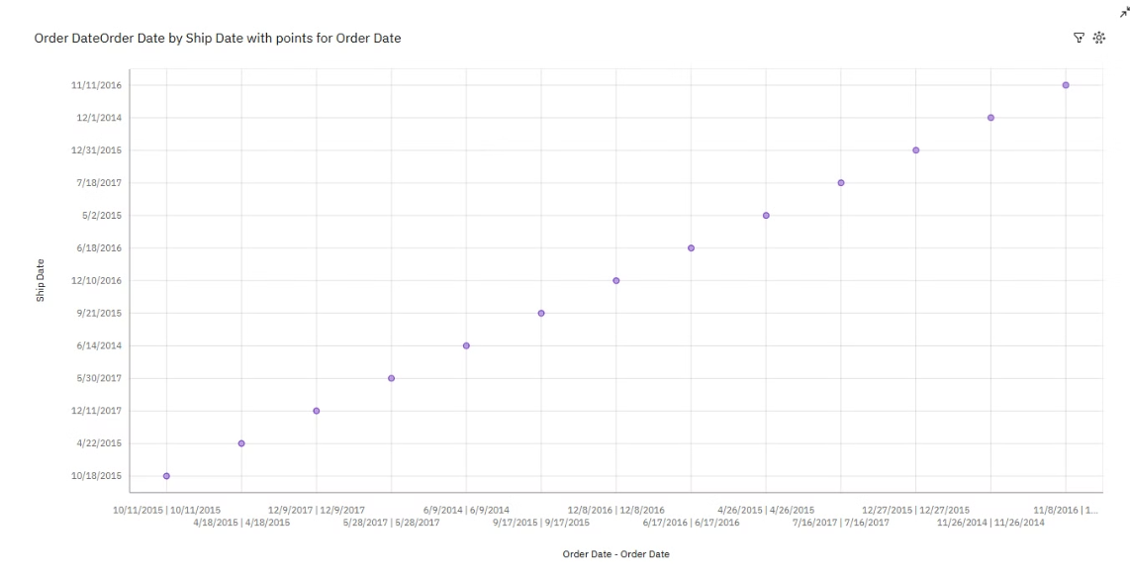
SHIP DATE WITH ORDER DATE(SCATTER PLOT)
The overall number of results for Ship Date is 13.The total number of results for Order ID, across all ship modes, is 25. Ship Mode Standard Class has the highest Country due to City Chester. City Oklahoma City has the highest Country at 2, out of which Ship Mode First Class contributed the most at 1. The overall number of results for Ship Date is 13.

Slide 13

Conclusion and Business Impact
Improved Inventory Management
Targeted Marketing Strategies
Accurately predicting future demand allows for optimized inventory levels, minimizing stockouts and reducing storage costs.
By understanding customer behavior and sales trends, marketing efforts can be targeted to specific segments and time periods, maximizing ROI.
Enhanced Financial Planning
Forecasting future sales enables accurate revenue projections, facilitating financial planning, budgeting, and investment decisions.

